Slide 1
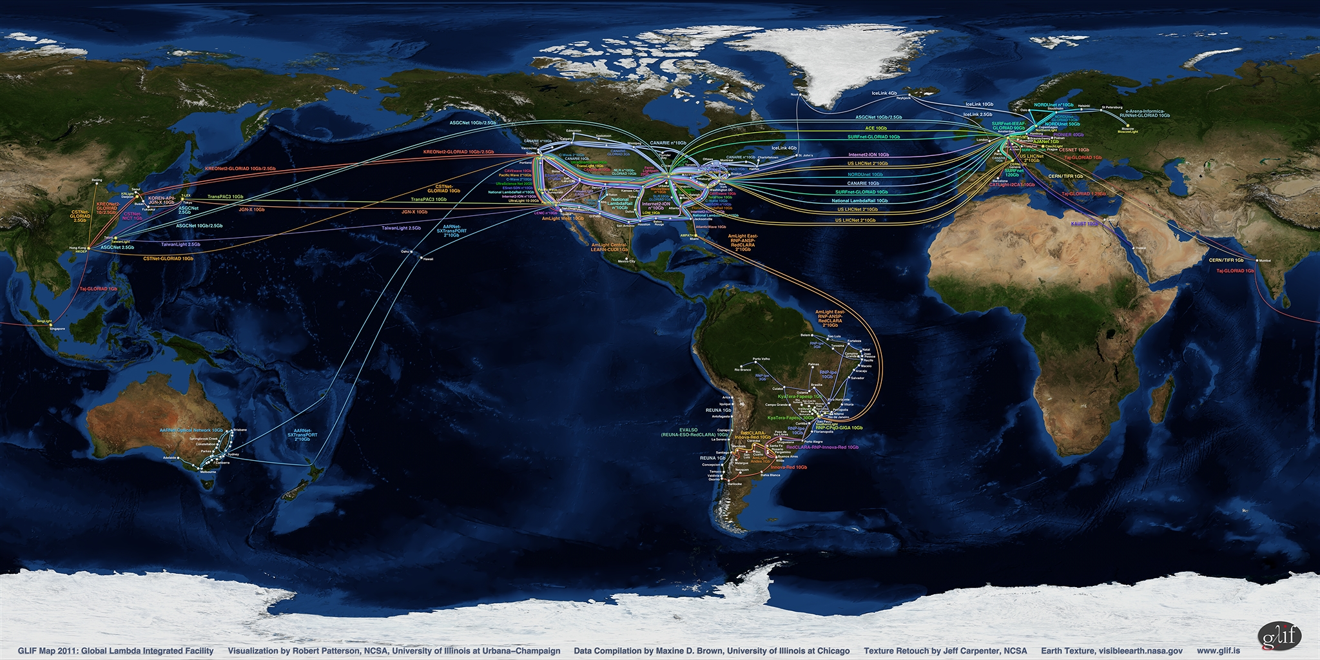
GLIF
Global Lambda Integrated Facility
Maxine Brown
Electronic Visualization Laboratory
University of Illinois at Chicago

Slide 2
What is GLIF?
GLIF is a consortium of institutions, organizations, consortia and country National Research & Education Networks who voluntarily share optical networking resources and expertise to develop the Global LambdaGrid for the advancement of scientific collaboration and discovery
GLIF provides forums that serve as models of global collaboration for technology and control plane development, research and applications, and governance.
www.glif.is

Slide 3
What is the LambdaGrid?
Today’s Grids and Clouds enable scientists to schedule computer resources and remote instrumentation over today’s “best effort” networks.
LambdaGrids enable scientists to also schedule bandwidth. Wave Division Multiplexing (WDM) technology divides white light into individual wavelengths (or “lambdas”) on optical fiber, creating parallel networks.
LambdaGrids provide deterministic networks with known and knowable characteristics.
  Guaranteed Bandwidth (data movement)
  Guaranteed Latency (collaboration, visualization, data analysis)
  Guaranteed Scheduling (remote instruments)

Slide 4
Why GLIF?
Motivations
Scientific: All science is global.
Political: A neutral forum in which to collaborate with colleagues worldwide to build a production quality Global LambdaGrid in support of e-science experiments.
Economic: As the cost of transoceanic bandwidth continues to become more affordable, National Research Networks have additional capacity they are willing to make available for use by application scientists, computer scientists and engineers.
Technical: Need to interconnect and interoperate production quality infrastructure for scientific experiments.

Slide 5
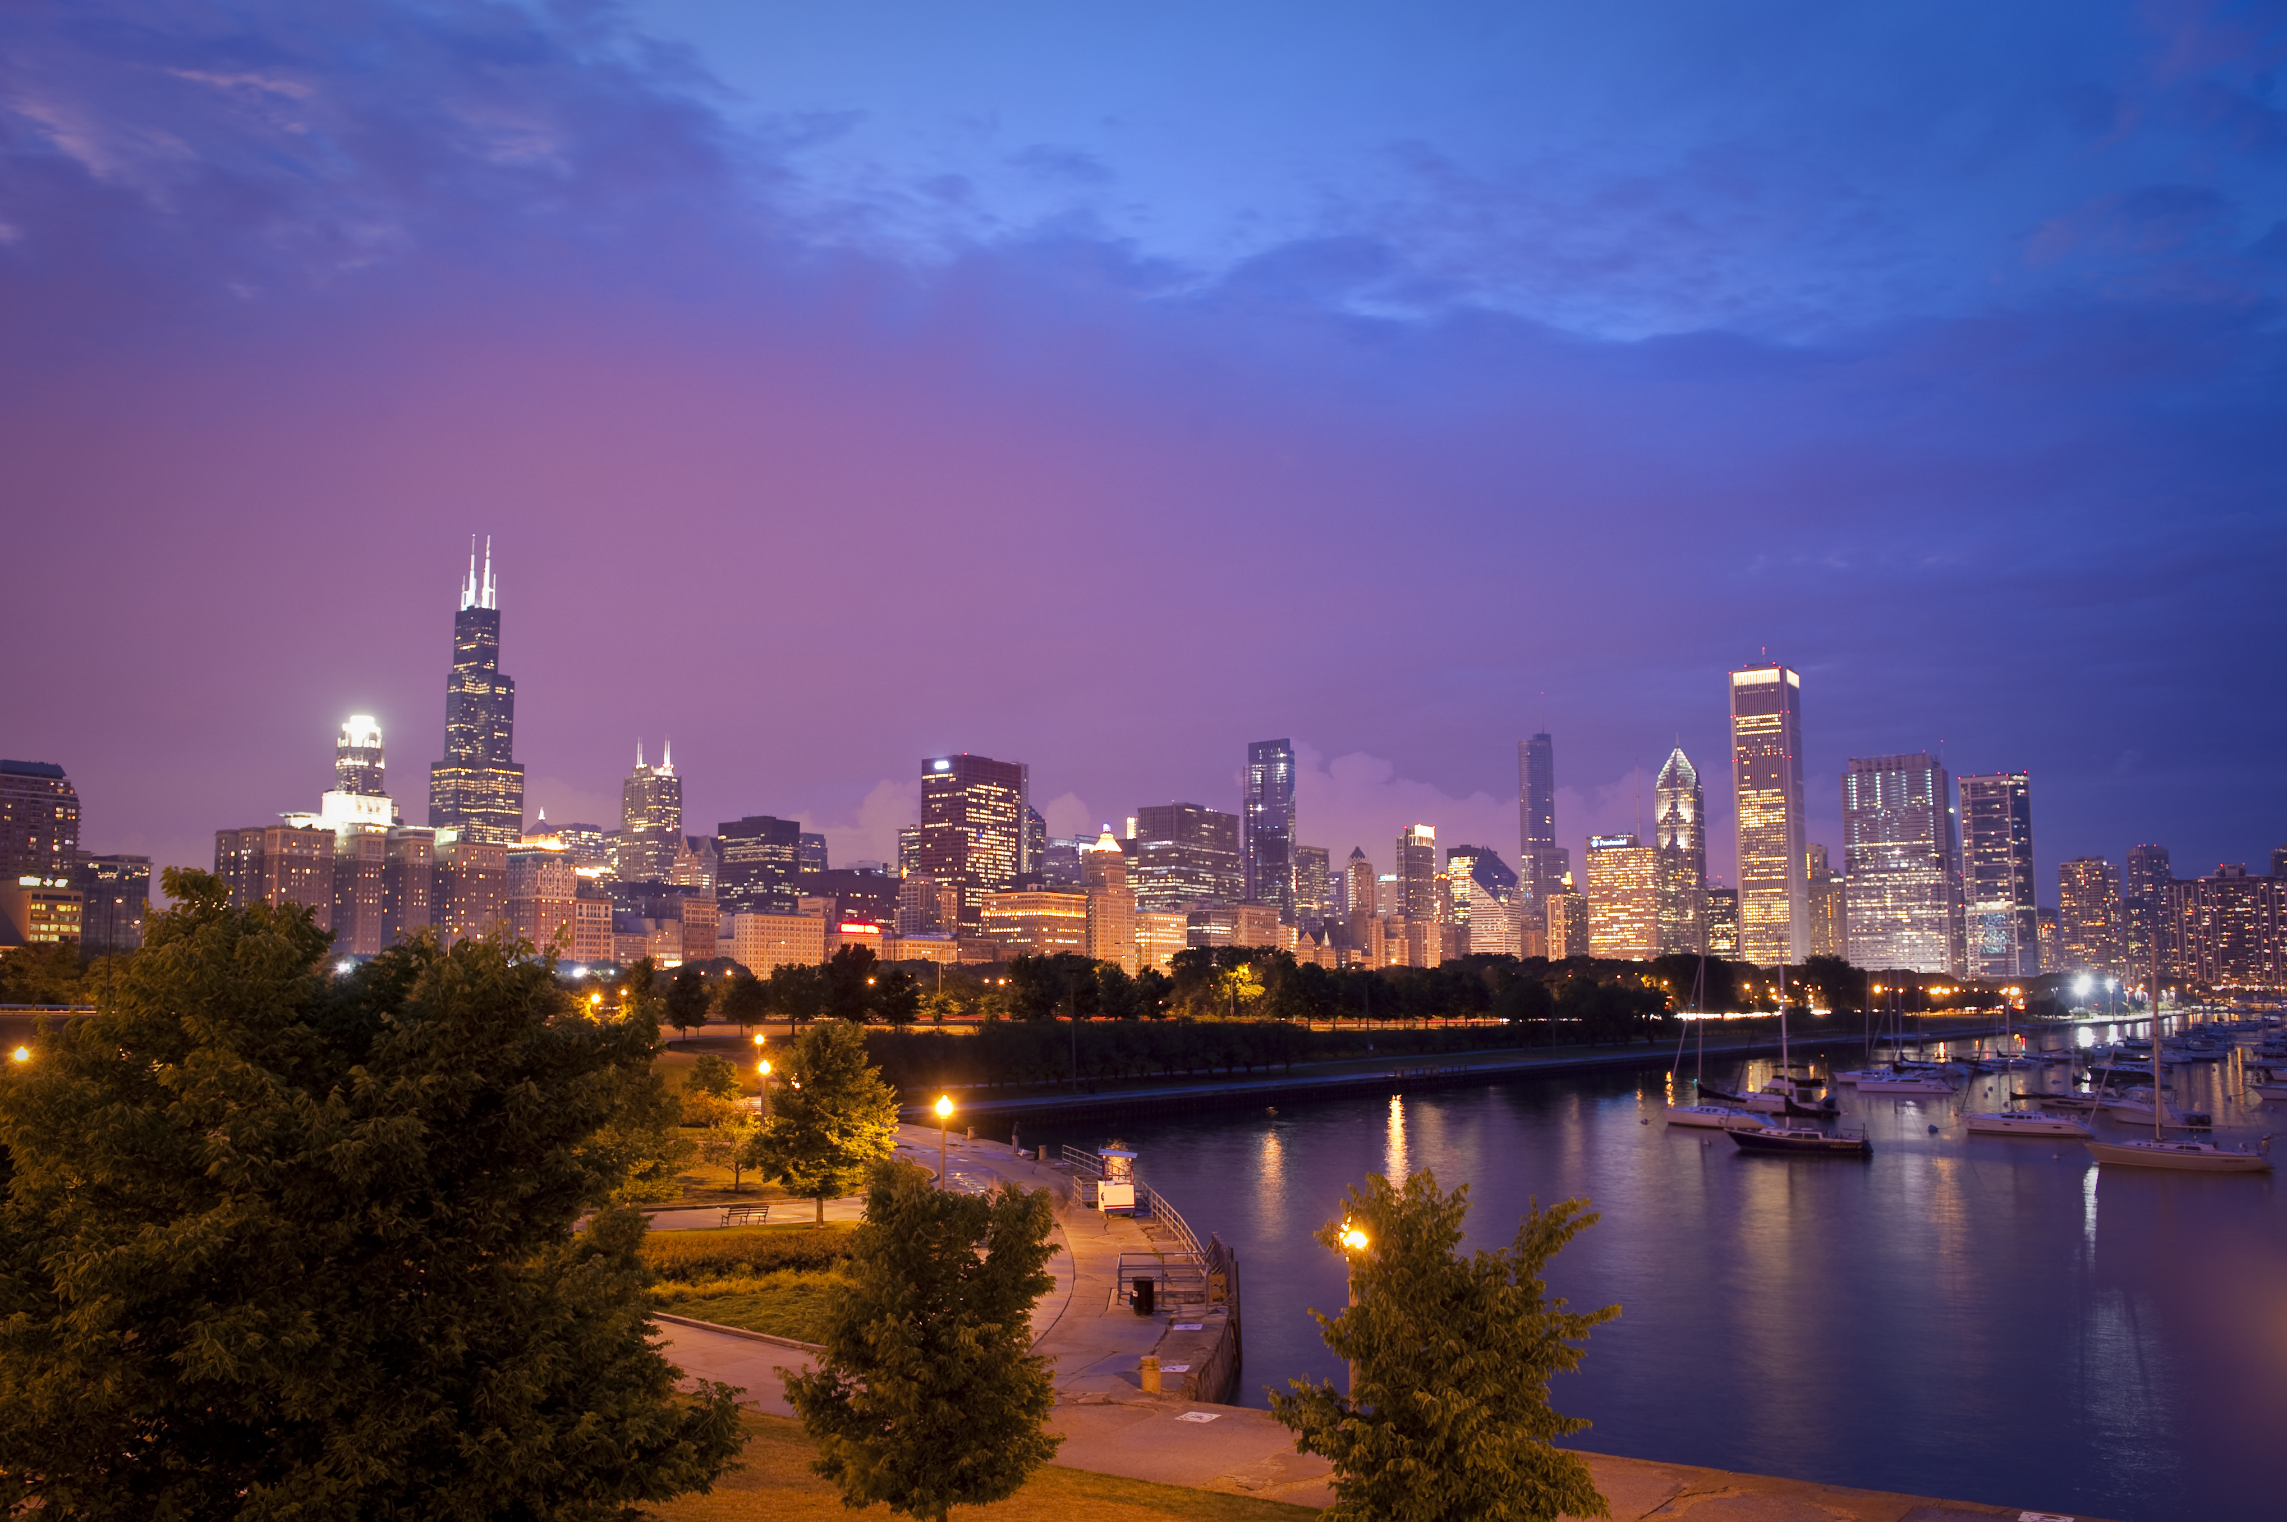
GLIF 2012
12th Annual Global LambdaGrid Workshop
October 11-12, 2012
Maxine Brown, Joe Mambretti, Alan Verlo, Linda Winkler
University of Illinois at Chicago
Northwestern University
Argonne National Laboratory

Slide 6
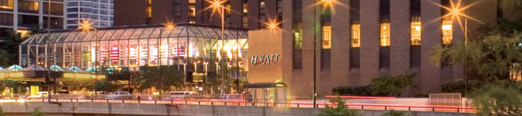
Chicago: A Busy Week!
MON Oct 8 | TUES Oct 9 | WED Oct 10 | THUR Oct 11 | FRI Oct 12
Hyatt Regency Chicago
Open Grid Forum (OFG) |  |  | GLIF 2012
8th IEEE International e-Science Tutorials |  | 8th IEEE International e-Science Conference
Microsoft e-Science Workshop

Slide 7
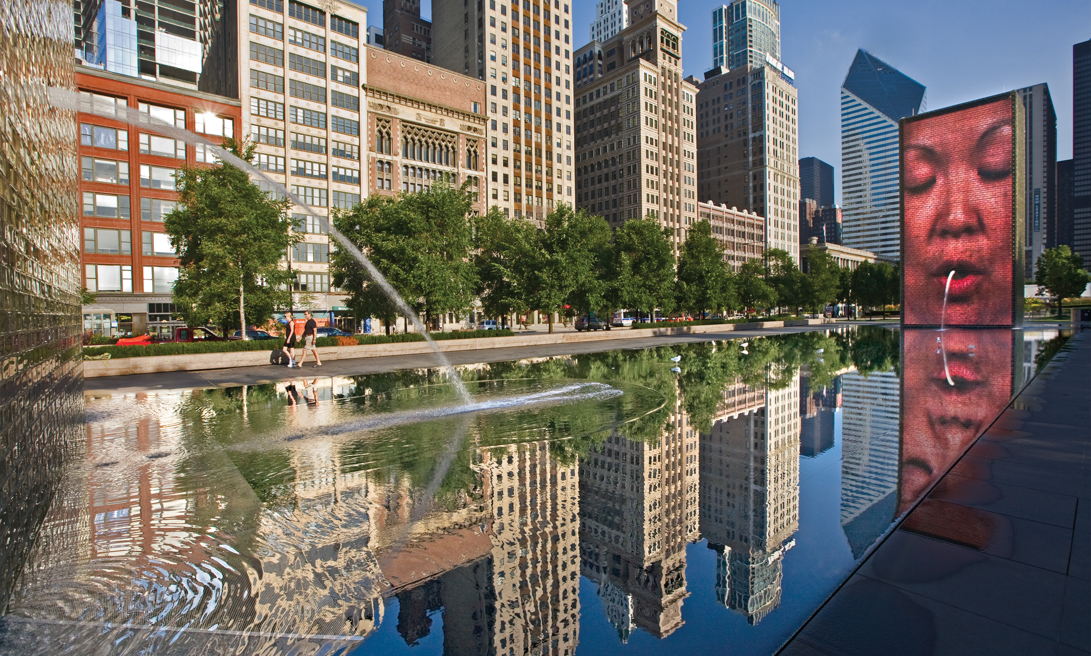
See You in October!

